Slide 1
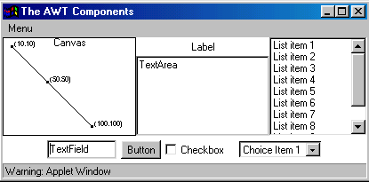
AWT Components

Slide 2
Using AWT Components
Component
  Canvas
  Scrollbar
  Button
  Checkbox
  Label
  List
  Choice
  TextComponent
      TextArea
      TextField
Component
  Container
    Panel
    Window
      Dialog
        FileDialog
      Frame
MenuComponent
  MenuItem
    Menu

Slide 3
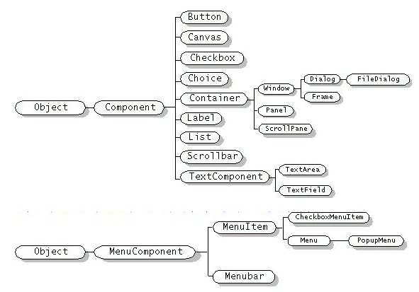

Slide 4
Frame
import java.awt.*;
public class TestFrame extends Frame {
public TestFrame(String title){
super(title);
}
public static void main(String[] args){
Frame f = new TestFrame("TestFrame");
f.setSize(400,400);
f.setLocation(100,100);
f.show();
}
}

Slide 5
How to Use Buttons?
public class TestButton extends Frame {
public TestButton(String title){
super(title);
Button hw = new Button("Hello World!");
add(hw);
}
….
}

Slide 6
How to Use Labels?
public class TestLabel extends Frame {
public TestLabel(String title){
super(title);
Label label1 = new Label();
label1.setText("Label1");
Label label2 = new Label("Label2");
label2.setAlignment(Label.CENTER);
Label label3 = new Label("Label3");
add(label1,"North");
add(label2,"Center");
add(label3,"South");
}
}

Slide 7
How to Use Checkboxes?
public class TestCheckbox extends Frame {
public TestCheckbox(String title){
super(title);
CheckboxGroup cbg = new CheckboxGroup();
Checkbox cb1 = new Checkbox("American Express",cbg,false);
Checkbox cb2 = new Checkbox("Visa",cbg,false);
Checkbox cb3 = new Checkbox("Mastercard",cbg,true);
add(cb1,"North");
add(cb2,"Center");
add(cb3,"South");
}
…
}

Slide 8
How to Use Choices?
public class TestChoice extends Frame {
public TestChoice(String title){
super(title);
Choice choice = new Choice();
choice.add("ichi");
choice.add("ni");
choice.add("san");
add(choice);
}

Slide 9
How to Use TextField & TextArea
public class TestText extends Frame {
public TestText(String title){
super(title);
TextField textField = new TextField(20);
TextArea textArea = new TextArea(5, 20);
textArea.setEditable(false);
textField.setText("TextField");
textArea.setText("TextArea Line1 \n TextArea Line2");
add(textField,"North");
add(textArea,"South");
}
…
}

Slide 10
How to Use Lists?
public class TestList extends Frame {
public TestList(String title){
super(title);
List l = new List(2, true); //prefer 2 items visible
l.add("zero");
l.add("uno");
l.add("dos");
l.add("tres");
l.add("cuatro");
l.add("cinco");
l.add("seis");
l.add("siete");
l.add("ocho");
l.add("nueve");
add(l);
}

Slide 11
How to Use Menus?
public class TestMenu extends Frame {
public TestMenu(String title){
super(title);
MenuBar mb = new MenuBar();
setMenuBar(mb);
Menu m1 = new Menu("Menu 1"); mb.add(m1);
MenuItem mi1_1 = new MenuItem("Menu Item 1_1"); m1.add(mi1_1);
m1.addSeparator();
MenuItem mi1_2 = new MenuItem("Menu Item 1_2"); m1.add(mi1_2);
Menu m2 = new Menu("Menu 2"); // mb.add(m2);
m1.add(m2);
MenuItem mi2_1 = new CheckboxMenuItem("Menu Item 2_1");
m2.add(mi2_1);
}
…

Slide 12
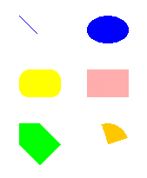
How to Use Canvases and Graphics Primitives?
For drawing geometric shapes, texts, and images
An abstract class
  the extended class must override paint()
Line
RoundRectangle
Polygon
Oval
Rectangle
Arc

Slide 13

drawLine(x1,y1,x2,y2)
class MyCanvas extends Canvas {
public void paint(Graphics g){
g.setColor(Color.blue);
int x1 = 161,
y1 = 186,
x2 = 181,
y2 = 206;
g.drawLine(x1,y1,x2,y2);
}
(x1,y1)
(x2,y2)

Slide 14

fillOval(x,y,w,h) drawOval(x,y,w,h)
g.setColor(Color.blue);
{
int x = 239,
y = 186,
w = 48,
h = 32;
g.fillOval(x,y,w,h);
}

Slide 15

fillPolygon(int[] xs, int[] ys) drawPolygon(int[] xs, int[] ys)
g.setColor(Color.green);
{
int xs[] = {161,161,185,209,185,161};
int ys[] = {310,334,358,334,310,310};
g.fillPolygon(xs,ys,6);
}

Slide 16

fillRect(x,y,w,h) drawRect(x,y,w,h)
g.setColor(Color.pink);
{
int x = 239,
y = 248,
w = 48,
h = 32;
g.fillRect(x,y,w,h);
}

Slide 17

fillRoundRect(x,y,w,h,rw,rh) drawRoundRect(x,y,w,h,rw,rh)
g.setColor(Color.yellow);
{
int x = 161,
y = 248,
w = 48,
h = 32,
roundW = 25,
roundH = 25;
g.fillRoundRect(x,y,w,h,roundW,roundH);
}

Slide 18

fillArc(x,y,w,h,sa,a) drawArc(x,y,w,h,sa,a)
g.setColor(Color.orange);
{
int x = 239,
y = 310,
w = 48,
h = 48,
startAngle = 20,
angle = 90;
g.fillArc(x,y,w,h,startAngle,angle);
}

Slide 19
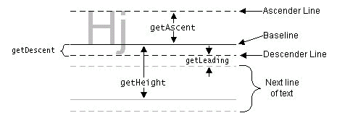
drawString(s,x,y)
FontMetrics
(x,y)

Slide 20
drawString, Font, & FontMetrics
class MyCanvas extends Canvas {
public void paint(Graphics g){
g.setFont(new Font("Dialog",0,20));
FontMetrics fm = g.getFontMetrics();
int x = 100;
int y = 100;
g.drawString("Hello",x,y);
y = y+fm.getHeight();
g.drawString("World",x,y);
}
}

Slide 21
drawImage(image,x,y,w,h,ob)
Image im = Toolkit.getDefaultToolkit().getImage(name);
g.drawImage(im, x, y, w, h, observer);

Slide 22
drawImage
public class TestImage extends Frame {
Image im;
public TestImage(String title){
super(title);
im = Toolkit.getDefaultToolkit().getImage("jp2.jpg");
if (im==null){
System.out.println("No image");
System.exit(0);
}
}
public void paint(Graphics g){
g.drawImage(im,0,0,im.getHeight(this),im.getWidth(this),this);
}
…
}

Slide 23
Layout of Components
BorderLayout
  north, south, west, east & center
FlowLayout
  left to right & top down
CardLayout
  stack of panels
GridLayout
  tabular form (rows & columns)
GridBagLayout
  tabular form(variable row heights and column widths)

Slide 24
Use Layout Managers
setLayout(new BorderLayout());
setLayout(new CardLayout(());
setLayout(new FlowLayout());
setLayout(new GridLayout(rows,columns,xgap,ygap));
Default layout managers
  Windows (Frames & Dialogs)
    BorderLayout
  Panels (Applets)
    FlowLayout

Slide 25
How to Use BorderLayout?
import java.awt.*;
public class TestBorderLayout {
public static void main(String[] args){
Frame f = new Frame("TestBorderLayout");
f.setSize(200,200);
f.add("North", new Button("North"));
f.add("South", new Button("South"));
f.add("East", new Button("East"));
f.add("West", new Button("West"));
f.add("Center", new Button("Center"));
f.setVisible(true);
}
}

Slide 26
How to Use FlowLayout?
import java.awt.*;
public class TestFlowLayout {
public static void main(String[] args){
Frame f = new Frame("TestFlowLayout");
f.setSize(200,200);
f.setLayout(new FlowLayout());
f.add(new Button("Button 1"));
f.add(new Button("Button 2"));
f.add(new Button("Button 3"));
f.add(new Button("Button 4"));
f.add(new Button("Button 5"));
f.setVisible(true);
}
}

Slide 27
How to Use CardLayout?
import java.awt.*;
public class TestCardLayout {
public static void main(String[] args){
Frame f = new Frame("TestCard Layout");
f.setSize(200,200);
f.setLayout(new CardLayout());
f.add("GraphicsPanel",new GraphicsPanel());
f.add("LabelPanel",new LabelPanel());
f.add("ButtonPanel",new ButtonPanel());
f.setVisible(true);
}
}

Slide 28
How to Use GridLayout?
import java.awt.*;
public class TestGridLayout {
public static void main(String[] args){
Frame f = new Frame("TestGridLayout");
f.setSize(200,200);
f.setLayout(new GridLayout(2,3));
f.add(new Button("Button 1"));
f.add(new Button("Button 2"));
f.add(new Button("Button 3"));
f.add(new Button("Button 4"));
f.add(new Button("Button 5"));
f.setVisible(true);
}
}

